Slide 1
TECH 2030
Faculty of Technical Sciences
Aarhus University

Slide 2

Strategic context
  AU’s Strategy 2030 is the foundation for Tech 2030.
  The vision of Aarhus University is to be an international research-intensive and campus-based university that develops individuals, shares knowledge and fosters positive societal transformation, grounded in foundational research, education and collaboration.
Aarhus
UniversitY

Slide 3


Aarhus
UniversitY
Aarhus
UniversitY

Slide 4

AARHUS UNIVERSITY’S VISION 2030
Aarhus University strives tirelessly to be an international research-intensive campus-based university that develops individuals, shares knowledge and fosters positive societal transformation, grounded in foundational research, education and collaboration. Aarhus University is determined to generate new insights and leverage its comprehensive disciplinary reach to develop research-based solutions to complex societal challenges
Aarhus
UniversitY

Slide 5
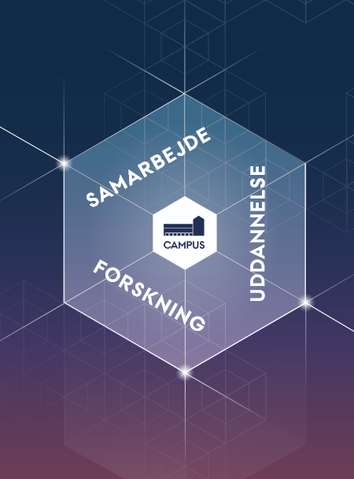
MISSION
Aarhus University’s mission is to contribute to society’s welfare and sustainable development. We achieve this through our research and research-based degree programmes of internationally distinguished excellence, and in close collaboration with the public and private sector and civil society.

Slide 6

VALUES
Freedom of expression and academic freedom
Academic excellence and integrity
Community and collaboration
Support and respect
.
Diversity, gender equality and inclusion
Democracy and involvement
v
v
v
v
v
v

Slide 7

Tech 2030
Tech is a collaborative and solution-oriented faculty.
We want to create the basis for green and digital solutions with high societal impact.
Aarhus
UniversitY

Slide 8
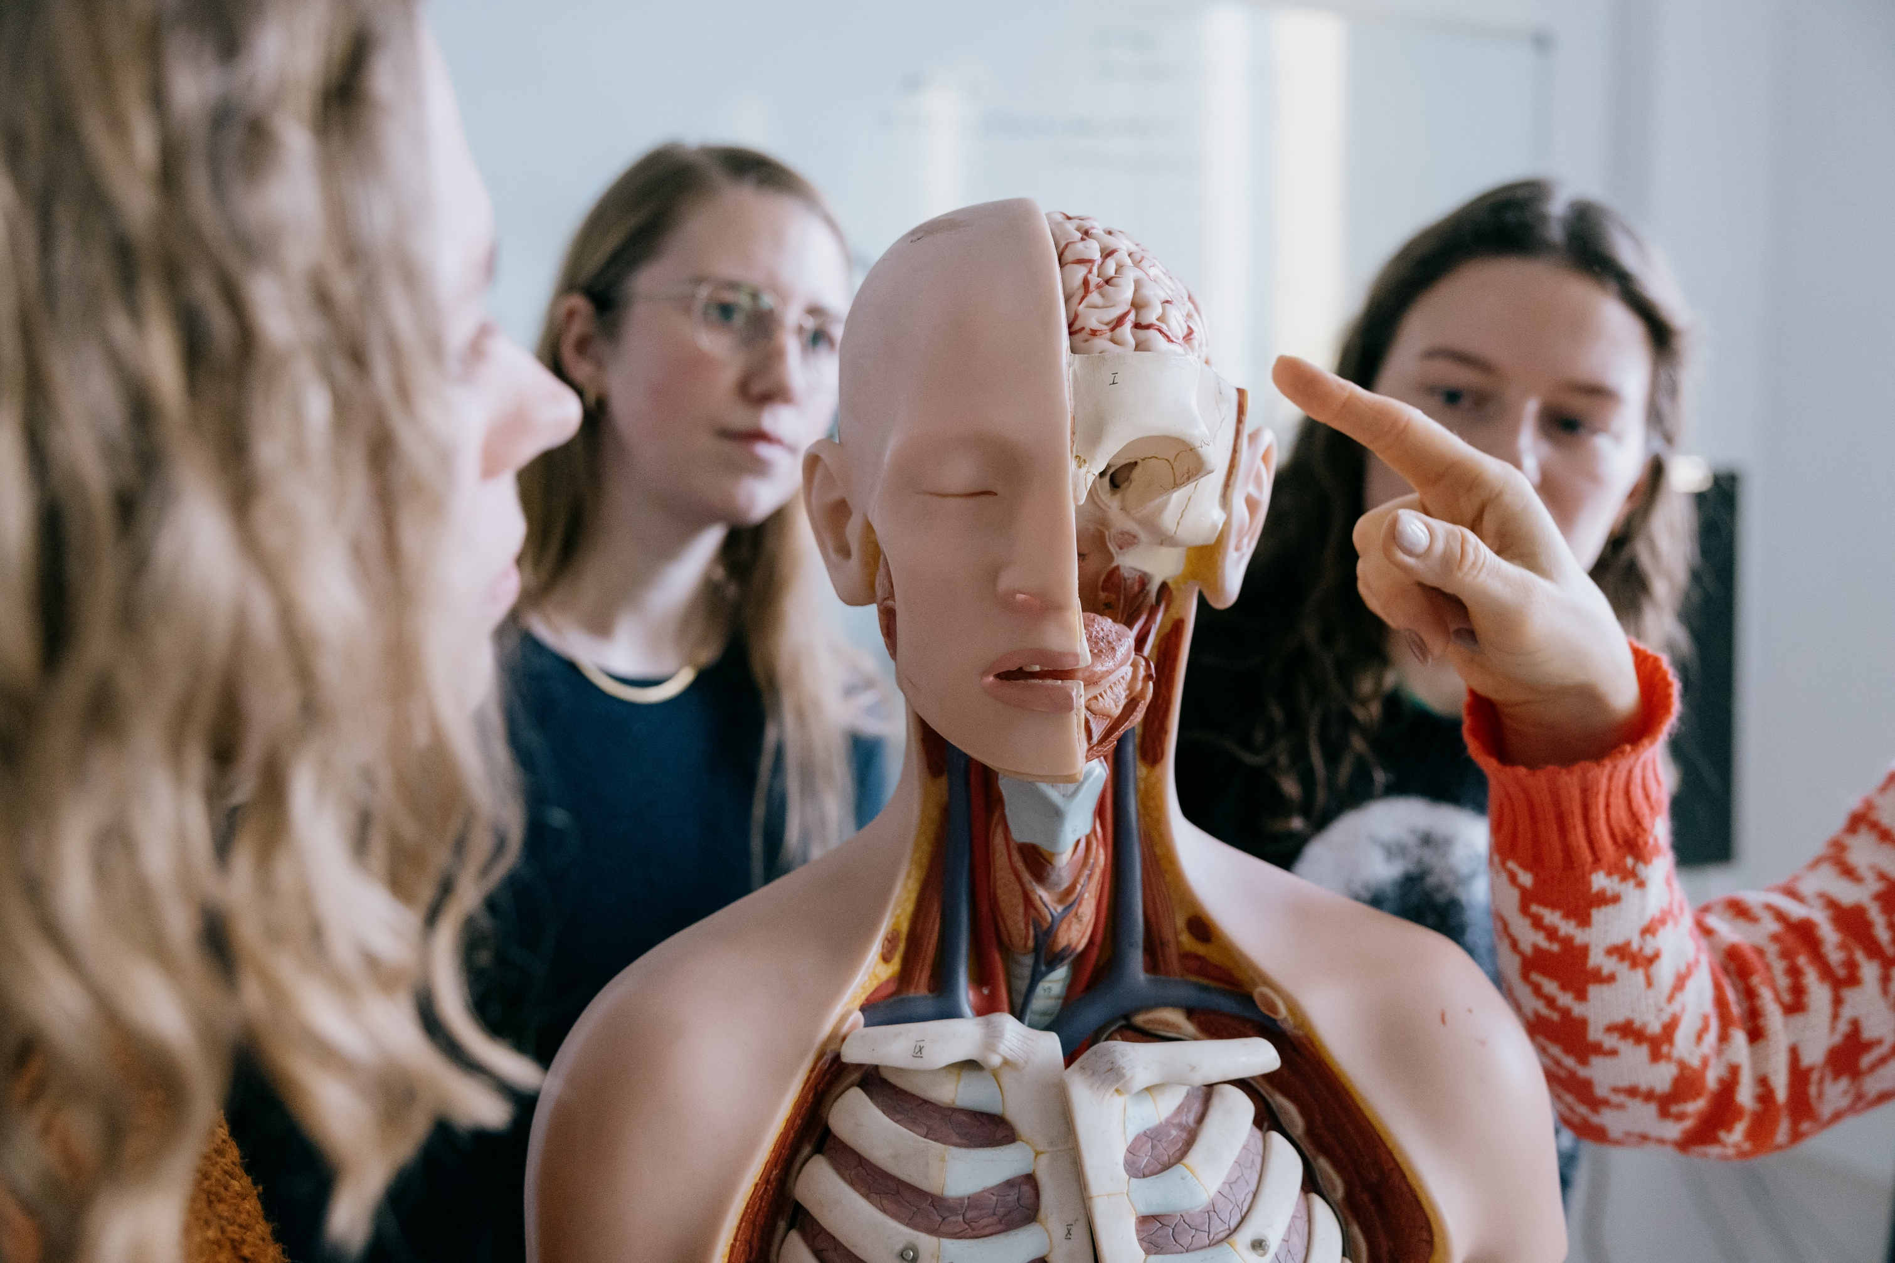

Tech impact: Resilience, innovation, and the mission‑oriented approach
  Resilience is key in a time characterized by geopolitical realignment and the threat of climate change.
  Sustainability and green and digital solutions are prerequisites for real, long-term resilience.
  Innovation is the incubator that will ensure an independent Europe, and innovation grows when we work in a mission- oriented way across disciplines.
  This is how Tech creates impact in a changing world.
Aarhus
UniversitY

Slide 9
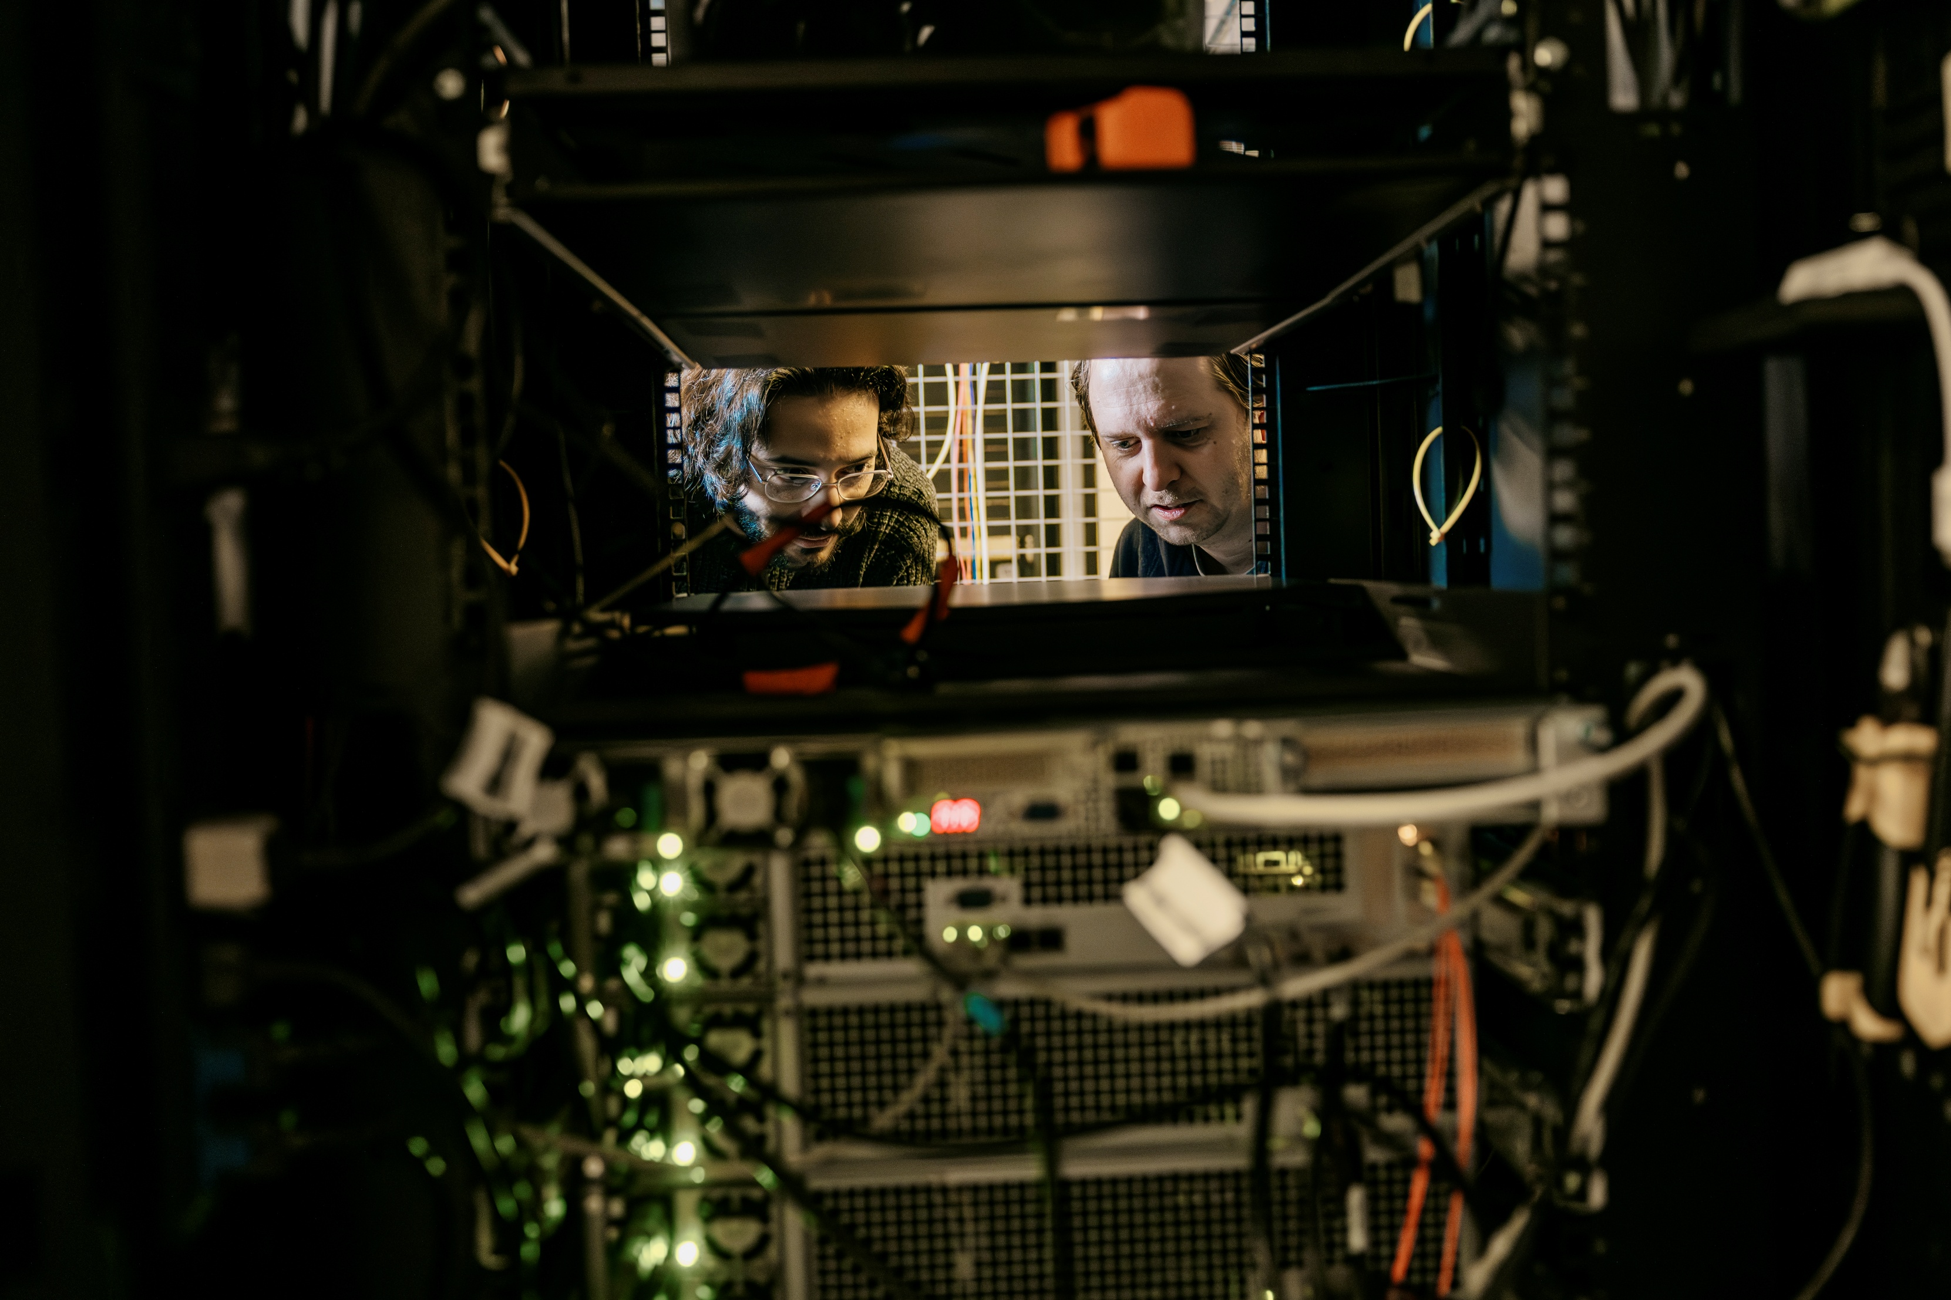
RESILIENCE:
In a time of political and environmental change, resilience is key.
By resilience we mean the capacity of a society to maintain robust self‑sufficiency even under strong external pressures of either economic, environmental, or political nature.
Tech contributes through our wide range of disciplines, enabling access to critical, innovative, and competitive technologies, through research, research-based education, and research-based policy advice, for example by addressing how to ensure and uphold safe and sustainable supplies of essentials such as clean water, food, energy, and technology.
Aarhus
UniversitY

Slide 10
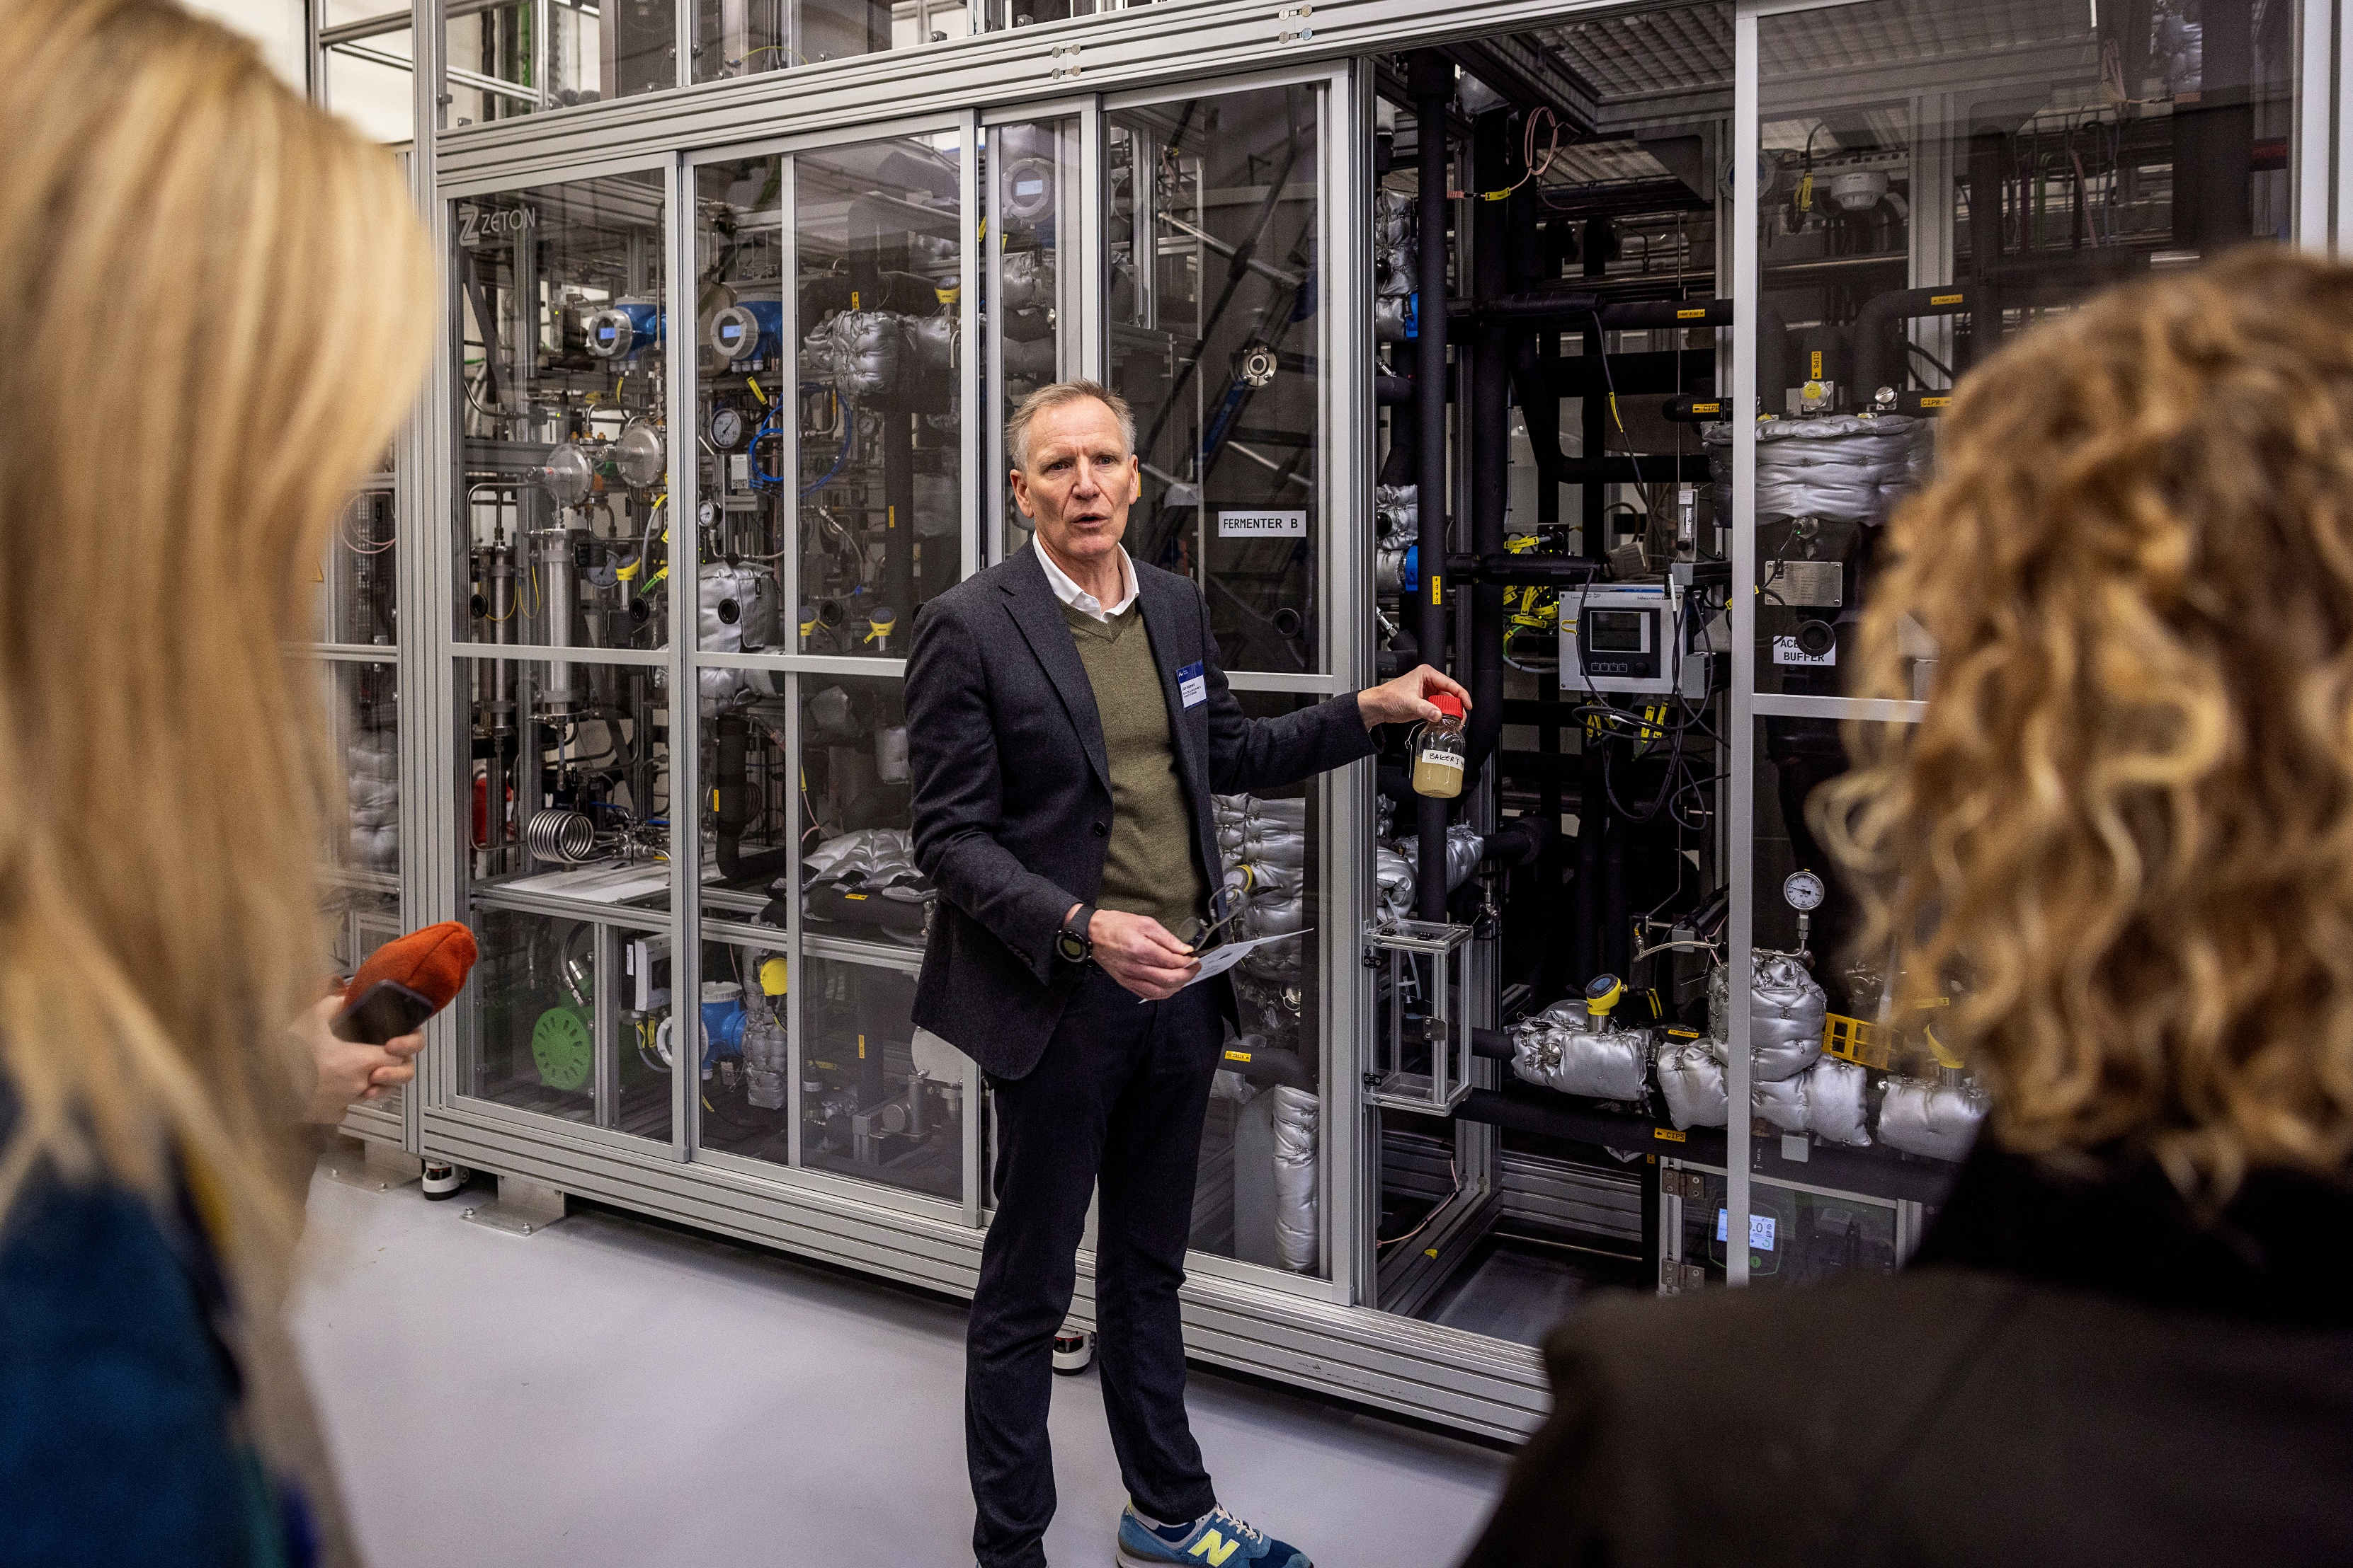
INNOVATION:
Innovation is the systematic transformation of new scientific knowledge, research-based ideas, and significant advances in low-TRL technologies into products and services, as well as preparing graduates to bring innovation into the labour market.
This is to ensure a responsible green transition, enhance global resilience, and competitiveness in a global market. As an innovative faculty, we will promote actions and a culture that lead to new ideas and solutions creating value for our surroundings.
Aarhus
UniversitY

Slide 11
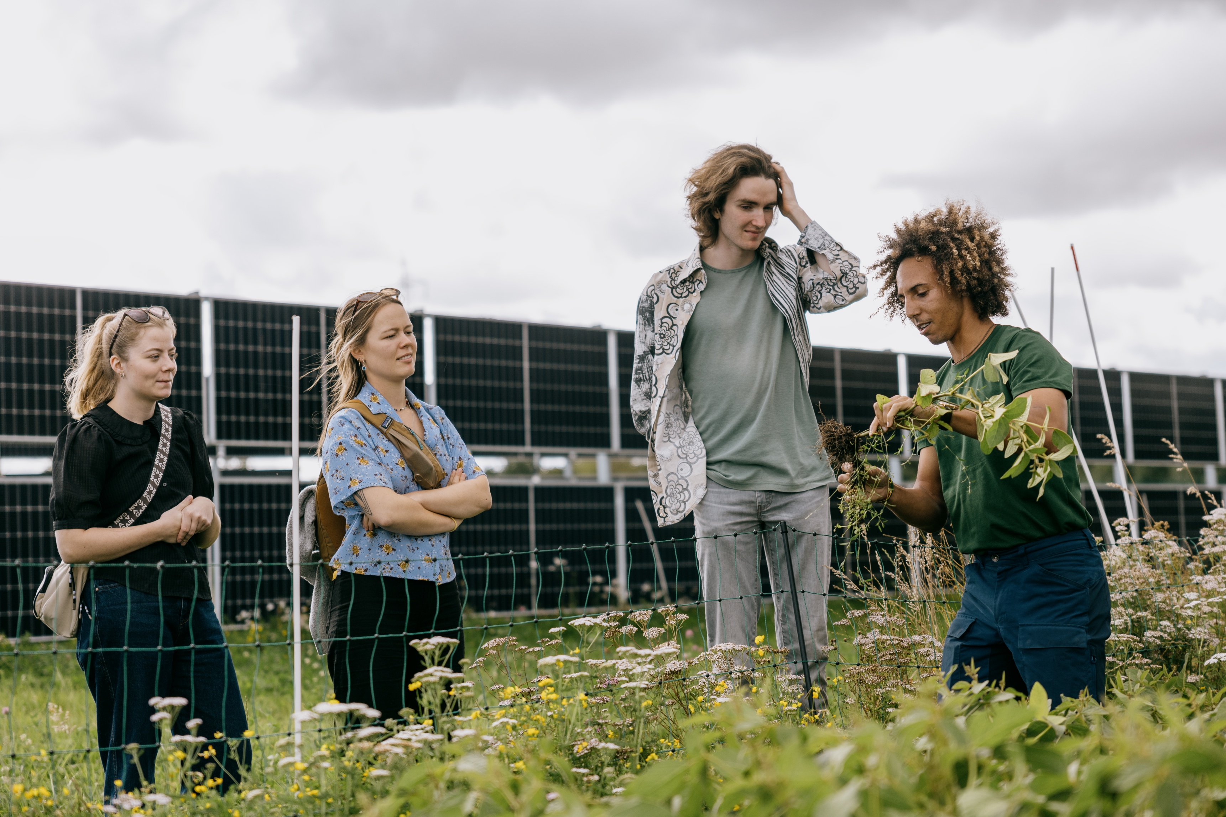
MISSION-ORIENTED:
At Tech, the mission-oriented approach is about directing research, and innovation towards solving complex societal or industrial problems.
To be mission-oriented means promoting a strong collaborative culture, interdisciplinarity, and strong collaborations, as well as understanding the need for leadership, governance, and management, which are alle necessary to fulfil mission goals.
Aarhus
UniversitY

Slide 12
Our four strategic focal points
  We prioritise developing new partnerships and collaborations
  We are a leader in research, talent development and science- based advice
  We meet our students where they are
  We deliver impact through a collaborative culture based on trust and respect

Slide 13
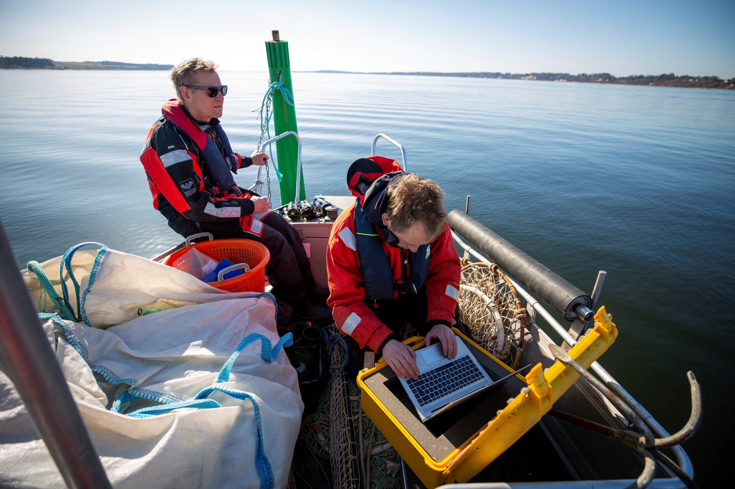
FOCAL-POINT 1: We prioritise developing new partnerships and collaborations
In the years ahead, we will further improve our ability to collaborate. We will strengthen our interdisciplinary collaboration with other academic environments – both within and outside AU.
We will work systematically to facilitate the sharing of knowledge, challenges and solutions across organisations and to foster mission-oriented partnerships aimed at creating maximum societal impact.
We will become the preferred meeting place for different partners to incubate new ideas together.
Aarhus
UniversitY

Slide 14
FOCAL-POINT 1: We prioritise developing new partnerships and collaborations
WE WILL
Prioritise collaboration with other academic environments both within and outside AU.
Build strategic partnerships and work systematically to create organisational pathways to facilitate the sharing of knowledge, challenges and solutions between partners.
Focus on mission-oriented partnerships with maximum societal impact.
Establish Tech as a visible and sought-after facilitator of multiparty collaborations.
Promote Tech as a meeting place for different partners to develop new ideas.
Aarhus
UniversitY

Slide 15
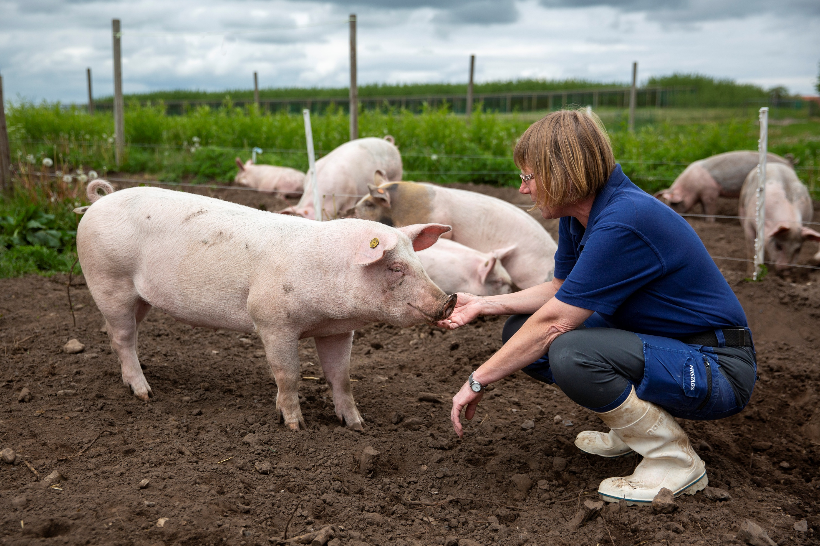
FOCAL-POINT 2: We are a leader in research, talent development and science-based advice
Going forward, we will position ourselves as a trusted key contributor to science-based solutions that address complex challenges across the public and private sectors and society as a whole.
Tech will actively support this ambition by strengthening its science-based advisory services, innovation and entrepreneurship in close collaboration with internal and external stakeholders.
We will continue to build a resilient, agile research organisation that bridges basic and applied research with innovation to ensure relevance and excellence.
To strengthen long-term capabilities, we will attract a diverse pool of new talent and invest in the development of our existing staff across all levels of the organisation.
Aarhus
UniversitY

Slide 16
FOCAL-POINT 2: We are a leader in research, talent development and science-based advice
WE WILL
Prioritise both curiosity-driven and mission-oriented research that is recognised and respected globally.
Prepare the organisation to have a mission-oriented approach, by establishing a strong governance structure, including impact assessment and guidance on the direction of research, advice and innovation.
Meet talents where they are when recruiting and support their development in line with their individual needs as well as the needs of the faculty.
Consolidate our position as the preferred national supplier of science-based advice by increasing and diversifying our research funding and continually improving the quality of our advice.
Strengthen our innovation capability by expanding and diversifying our collaboration with external stakeholders.
Build and acknowledge Tech’s culture around talent development, science-based advice, entrepreneurship and innovation.
Aarhus
UniversitY

Slide 17
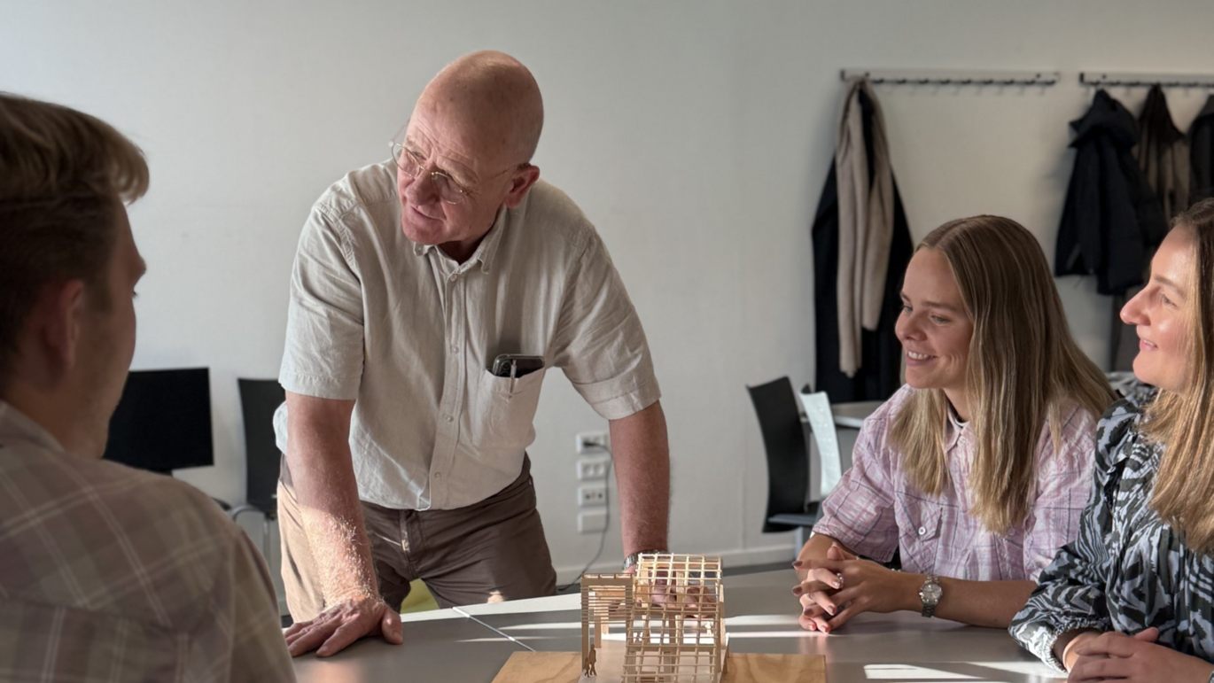
FOCAL-POINT 3: We meet our students where they are
All students start their degree programmes with individual aspirations, ambitions, knowledge and competencies. To accommodate all our students, we need to know more about the competencies they possess when starting their degrees.
Our degree programmes and teaching activities must engage and activate students and support their academic and personal development on the paths they choose.
Research groups can play a valuable role in sparking this engagement—through research internships, thesis collaborations and co-creation activities that bridge education and research.
Aarhus
UniversitY

Slide 18
FOCAL-POINT 3: We meet our students where they are
WE WILL
Recognise and support students’ academic and personal development by building on their individual needs, strengths and aspirations.
Provide our students with the space and opportunity to engage in, and contribute to, solving major societal challenges in collaboration with other disciplines – and help them develop the skills they need to engage in fruitful interdisciplinary collaboration, which we must view as a core competence.
Encourage innovation and entrepreneurship and build soft skills.
Help students acquire high-level academic qualifications and capabilities.
Foster a common culture for how we design degree programmes in support of these goals.
Aarhus
UniversitY

Slide 19
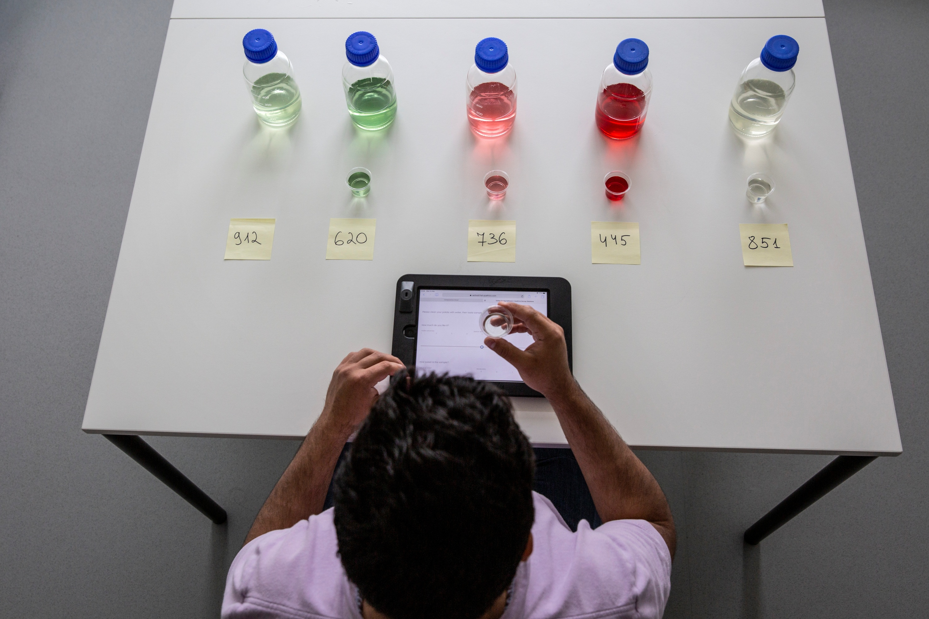
FOCAL-POINT 4: We deliver impact through a collaborative culture based on trust and respect
We must foster a resilient and collaborative culture at Tech in order to successfully navigate a landscape of constant change and challenges and to enhance the individual’s ability to deliver impact. A collaborative culture is essential for innovation because it promotes trust, respect and commitment to collective success. Sustaining a collaborative culture requires openness and ongoing dialogue, and it is crucial that we actively nurture this culture across the faculty and the university as a whole.
Tech is committed to the inclusion of diverse voices to ensure that members of the faculty feel empowered to speak their minds, continue their learning and deal with the unknown.
We are also dedicated to fostering an open-minded culture that overcomes resistance and learns from failure. While Tech will remain discipline-based structurally, the faculty is committed to fostering a culture of flexibility and openness to collaboration that overcomes barriers as well as driving and accelerating mission-oriented success.
Aarhus
UniversitY

Slide 20
FOCAL-POINT 4: We deliver impact through a collaborative culture based on trust and respect
WE WILL
Be the collaborative faculty.
Ensure that we adapt to the ever-changing needs and demands for solutions that our faculty can provide.
Co-create with partners both within and outside AU.
Develop and maintain a collaborative culture built on trust in and respect for each other at all levels.
Support a culture that values diversity as a driver of learning, innovation and shared success.
Aarhus
UniversitY

